Slide 1
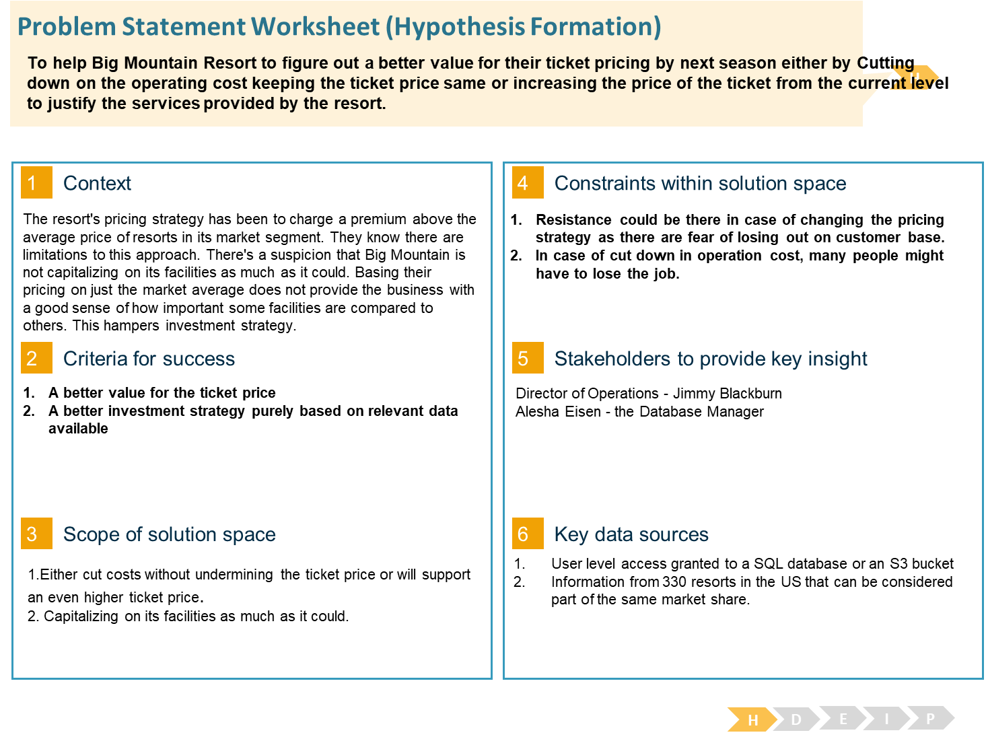

Slide 2
Key Findings
It seems that the more chairs a resort has to move people around, relative to the number of runs, ticket price rapidly plummets and stays low. What we may be seeing here is an exclusive vs. mass market resort effect; if you don't have so many chairs, you can charge more for your tickets, although with fewer chairs you're inevitably going to be able to serve fewer visitors.
Your price per visitor is high but your number of visitors may be low. Something very useful that's missing from the data is the number of visitors per year.
Big Mountain Resort modelled price is $95.87, actual price is $81.00. Even with the expected mean absolute error of $10.39, this suggests there is room for an increase.

Slide 3
Scenarios:
Big Mountain is doing well for vertical drop, but there are still quite a few resorts with a greater drop.
Big Mountain is very high up the league table of snow making area.
Big Mountain has amongst the highest number of total chairs, resorts with more appear to be outliers.
Most resorts have no fast quads. Big Mountain has 3, which puts it high up that league table. There are some values much higher, but they are rare.
Big Mountain compares well for the number of runs. There are some resorts with more, but not many.
Big Mountain has one of the longest runs. Although it is just over half the length of the longest, the longer ones are rare.
The vast majority of resorts, such as Big Mountain, have no trams.
Big Mountain is amongst the resorts with the largest amount of skiable terrain.

Slide 4
Recommendations:
Permanently closing down up to 10 of the least used runs. This doesn't impact any other resort statistics.
Increase the vertical drop by adding a run to a point 150 feet lower down but requiring the installation of an additional chair lift to bring skiers back up, without additional snow making coverage
Same as number 2, but adding 2 acres of snow making cover
Increase the longest run by 0.2 mile to boast 3.5 miles length, requiring an additional snow making coverage of 4 acres
The expected number of visitors over the season is 350,000 and, on average, visitors ski for five days. Assume the provided data includes the additional lift that Big Mountain recently installed.

Slide 5
Validations:
The model says closing one run makes no difference. Closing 2 and 3 successively reduces support for ticket price and so revenue. If Big Mountain closes down 3 runs, it seems they may as well close down 4 or 5 as there's no further loss in ticket price. Increasing the closures down to 6 or more leads to a large drop.
Although the longest run feature was used in the linear model, the random forest model (the one we chose because of its better performance) only has longest run way down in the feature importance list.

Slide 6
Conclusion:
After carefully considering all the scenarios and features, we could observe that Increasing the longest run by 0.2 mile to boast 3.5 miles length, is the only scenario that leads to a positive effect on the revenue not to that extent but it is having an impact, requiring an additional snow making coverage of 4 acres
Rest of the scenarios and features don’t have any significant effect on the ticket pricing henceforth not recommended to make any significant changes on those. But if we can cut down on operating cost on those, then it could save the resort some money.

